Slide 1
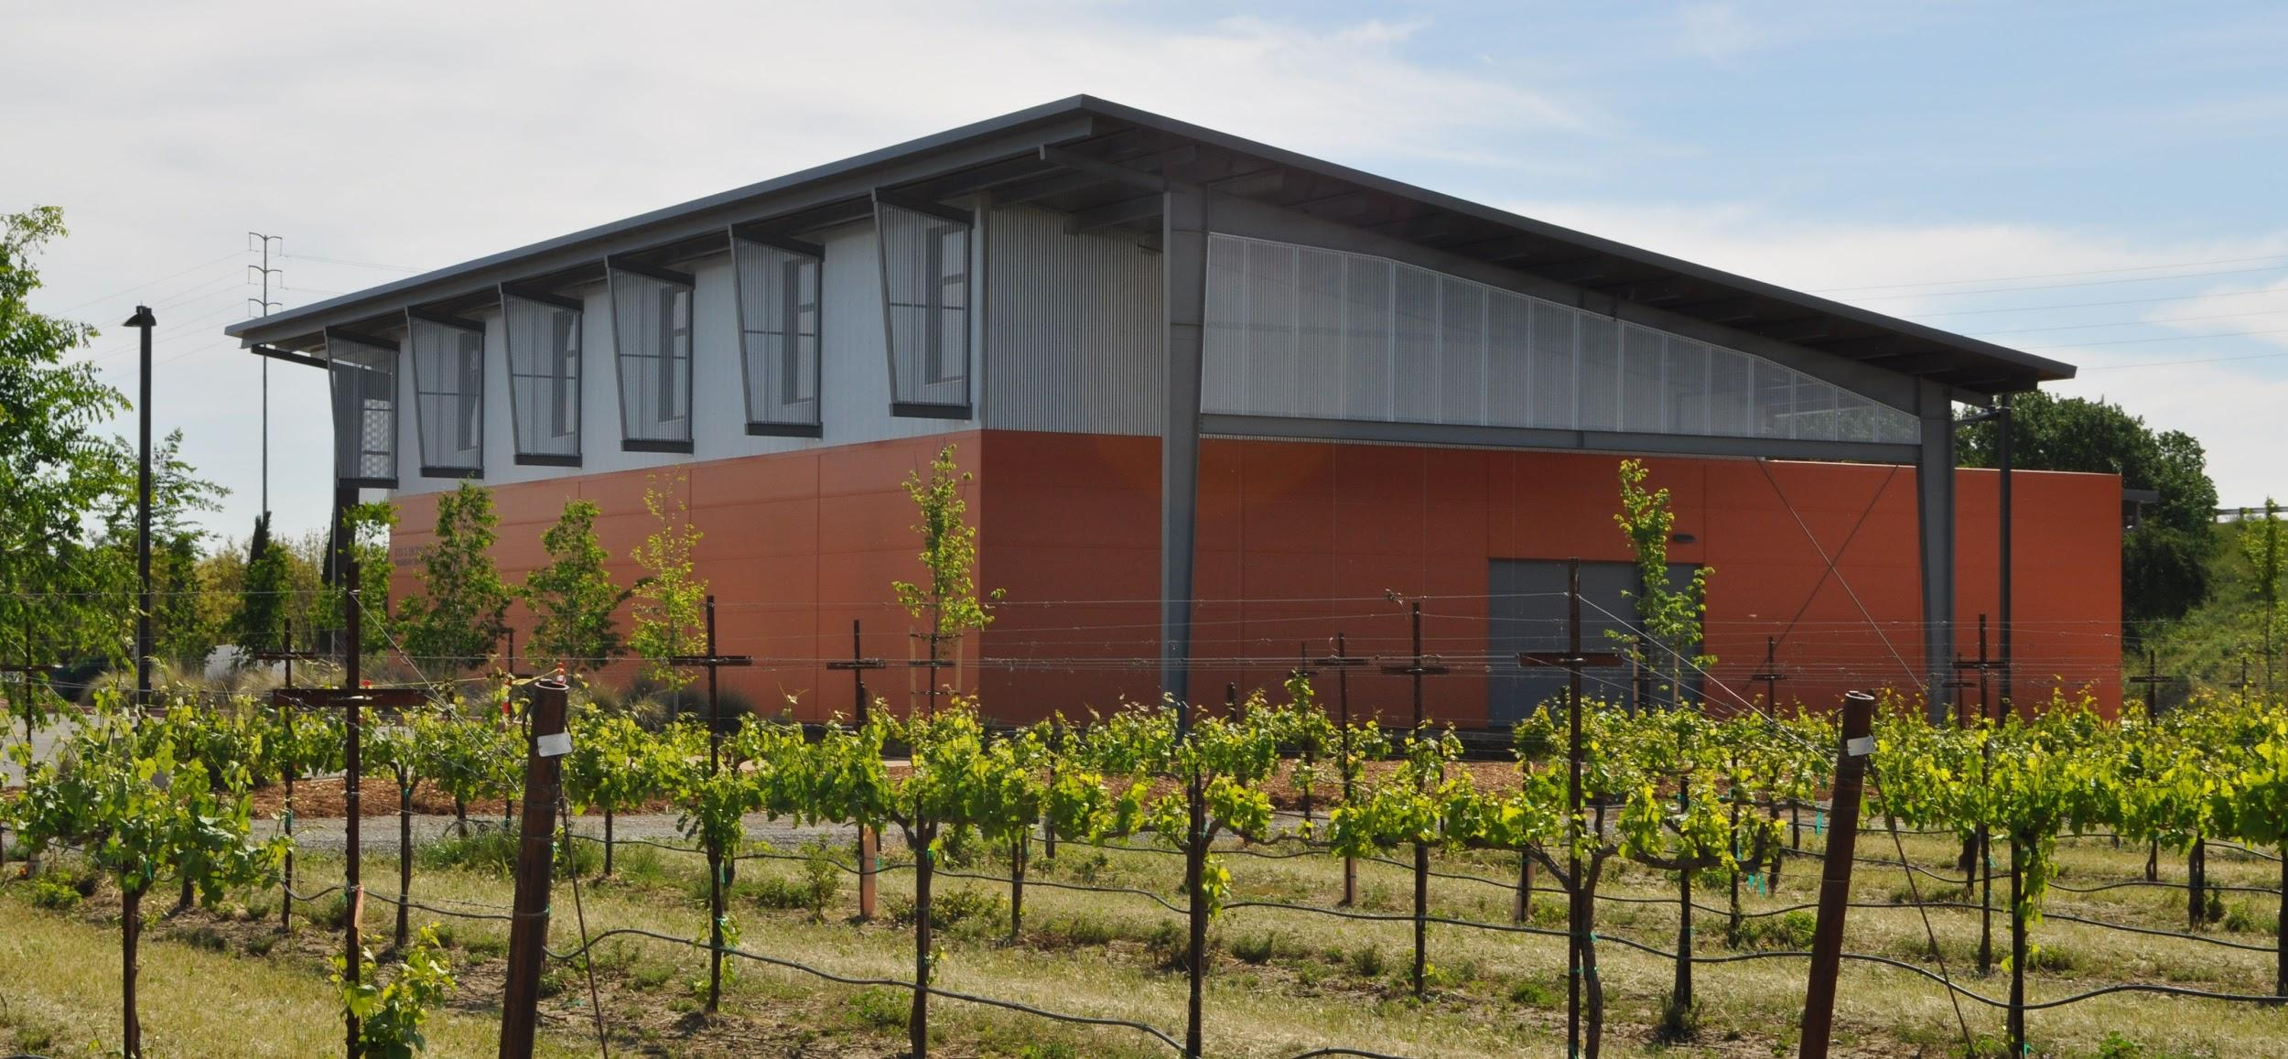

S.T.E.M
Team Beta: Advanced Weather Station
Chad Timmins
David Killeen
Erik Zhang
Jeffrey Kung
Robin Johnston

Slide 2
Why S.T.E.M.?
Against Tule, S.T.E.M.:
Low Cost vs. $1500
Lower Price for component replacements vs. $250
Does not require minimum purchase
Measures actual soil moisture content
Measures actual leaf temperature
Against AquaSpy, S.T.E.M.:
Low Cost vs. $800
Measures leaf temperature
Sleeker Design

Slide 3
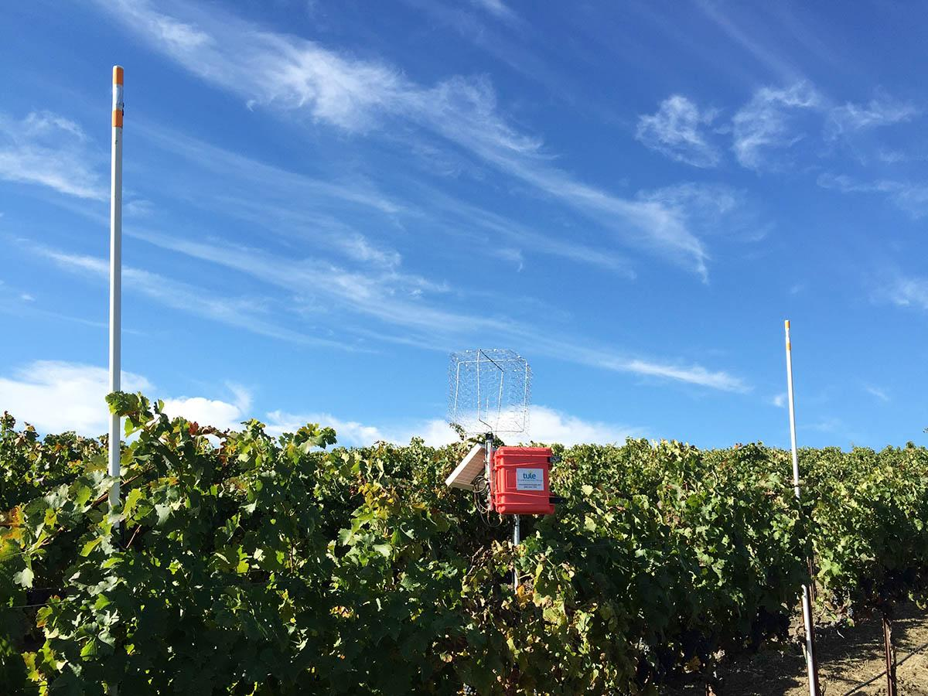
Tule’s Design

Slide 4
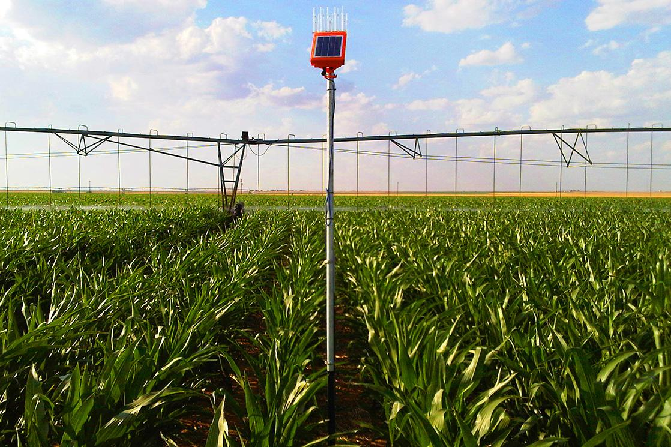
AquaSpy’s Design

Slide 5
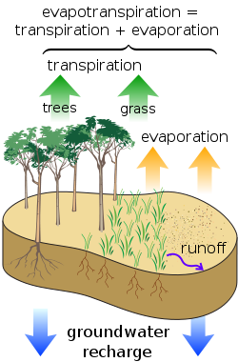
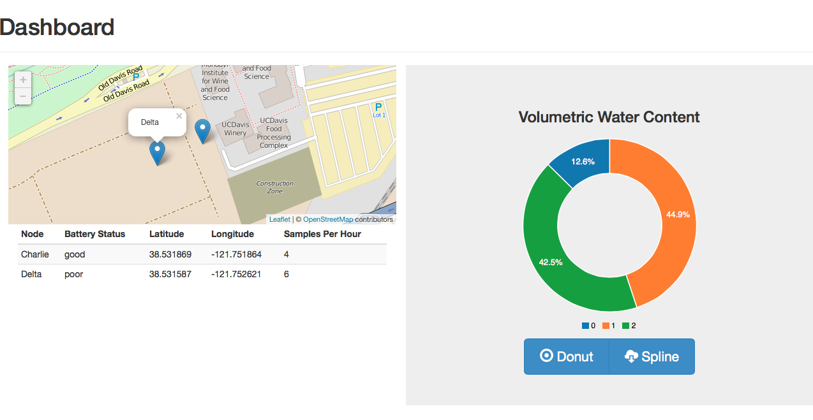
Overview
Monitors soil moisture levels and
leaf temperature
Cloud storage
Web interface

Slide 6
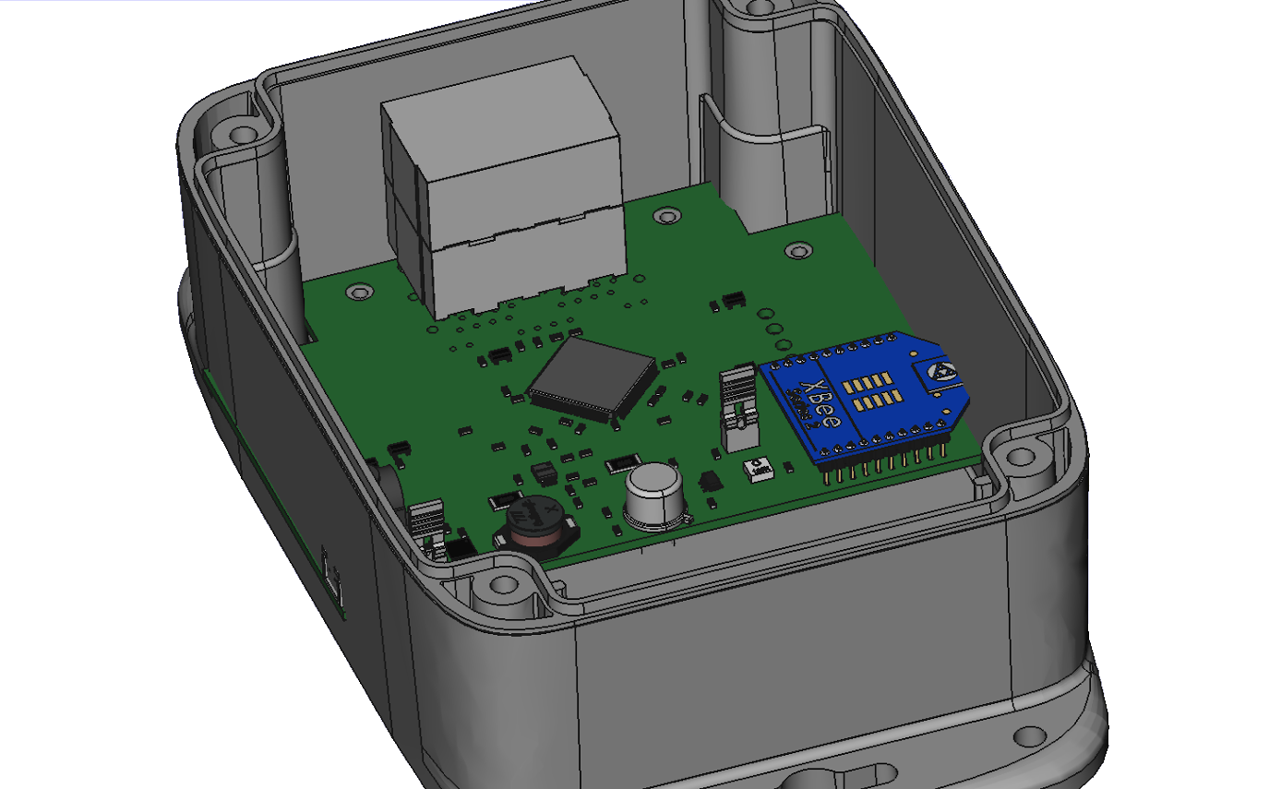
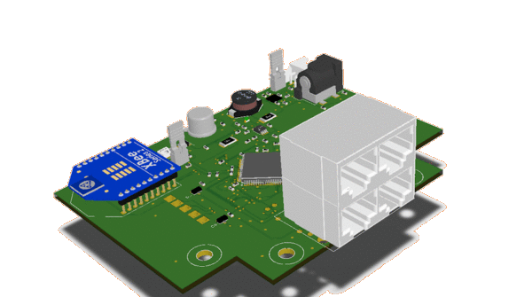
Design
IR Sensor
DC in
XBee
PSoC 5LP
Ethernet(Vegetronix)

Slide 7
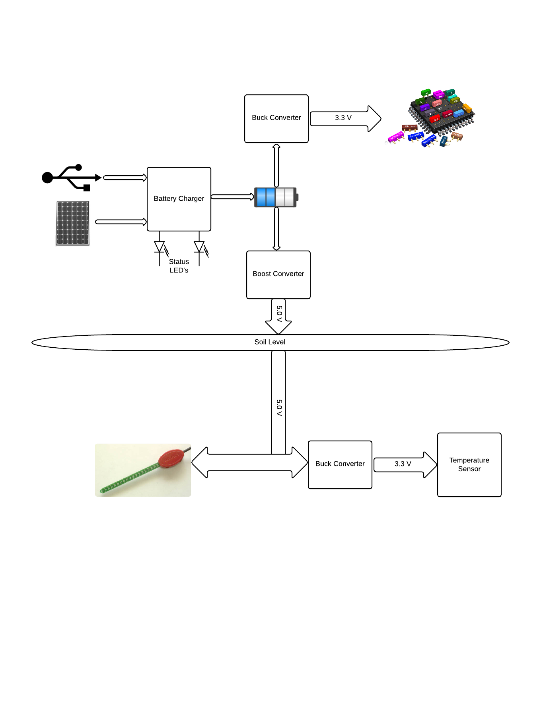
Power Architecture

Slide 8
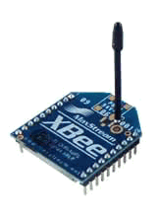
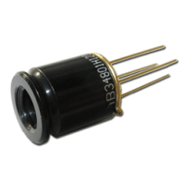

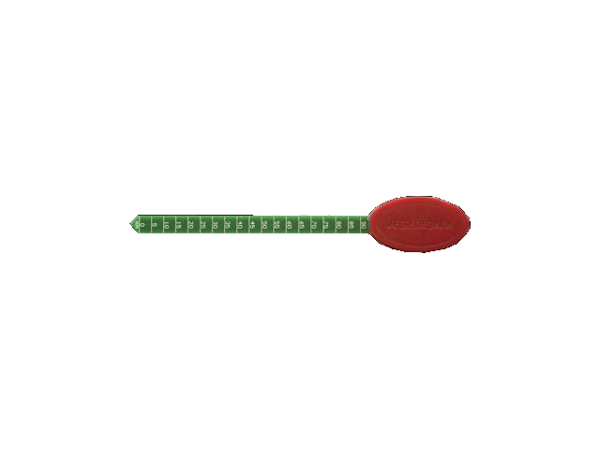
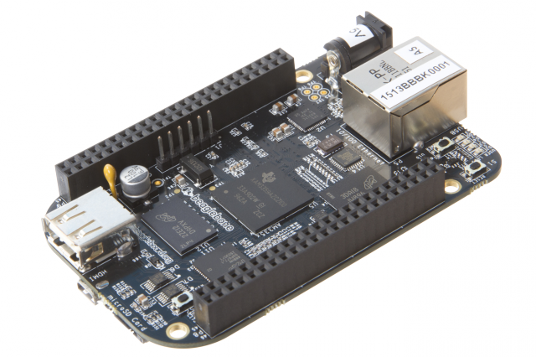
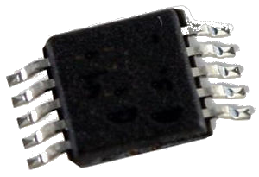

Communications
i2c
uart
i2c
i2c
adc

Slide 9
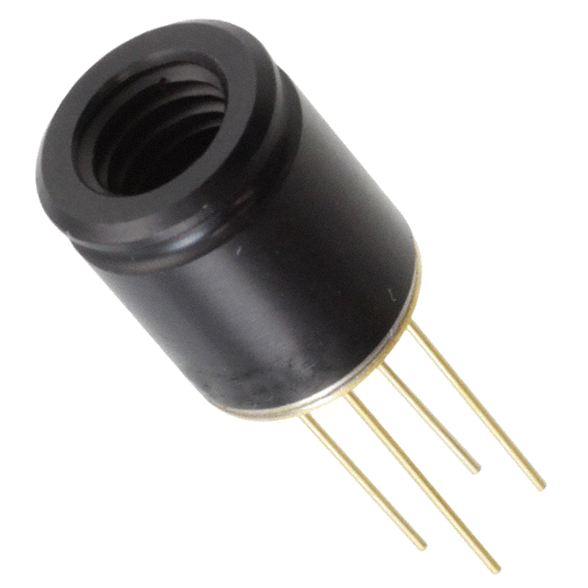
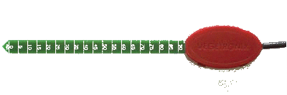
Sensors
MLX90620 IR Temperature | Vegetronix Volumetric Water Content | LM75BGD Temperature
Operating Temperature -40ºC to 85ºC Object Temperature-50ºC to 300ºC 16 x 4 Array 60° FOV Accuracy of ±1°C ±3% $88 | Operating Temperature -40ºC to 85ºC Buriable and waterproof Insensitive to salinity Corrosion resistant Accuracy of 2% at 25°C $38 - $54 Each | Operating Temperature -55ºC to 125ºC +/- 2ºC from 25ºC to 100ºC +/- 3ºC from 55ºC to 125ºC temperature resolution of 0.125ºC $0.59 Each

Slide 10
State Machine

Slide 11
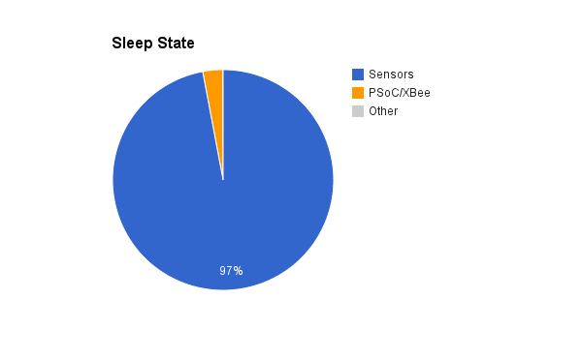
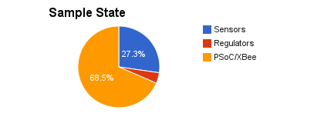
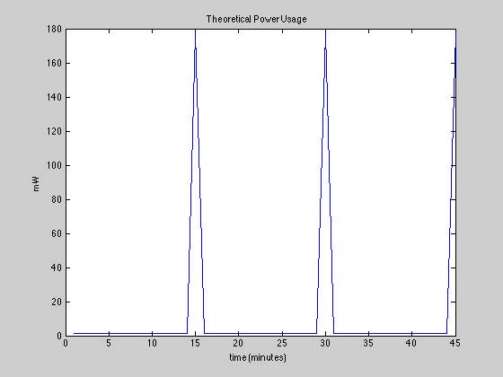
Power Consumption
1.36 mW x 60 min = 1.36 mWh
177.7 mW x 1 sec x 4 = .19744 mWh

Slide 12
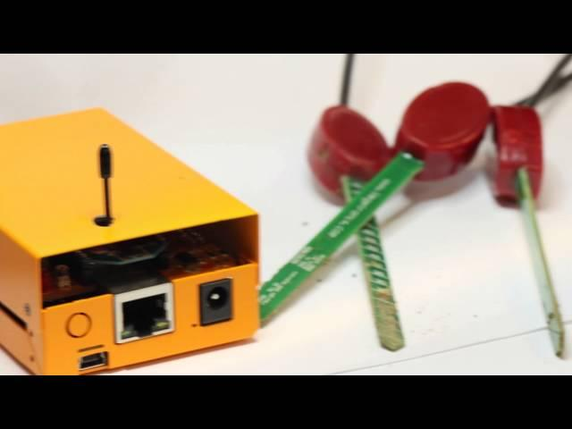

Slide 13


Acknowledgements
-Professor André Knoesen
-Dr. Jean-Jacques Lambert
-Nick Hosein and Saneel Khatri

